Slide 1
L5 functions
Acknowledgement: some slides taken from Yifeng Zhu’s courseware

Slide 2
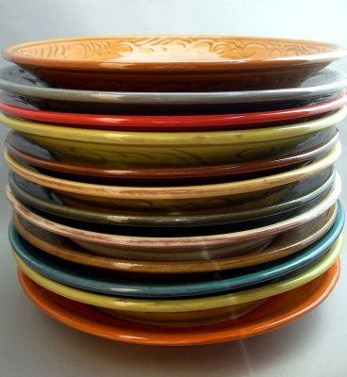
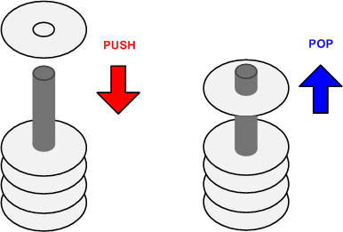
Stack
A Last-In-First-Out data structure
Only allow to access the most recently added item
Also called the top of the stack
Key operations:
push (add item to stack)
pop (remove top item from stack)

Slide 3
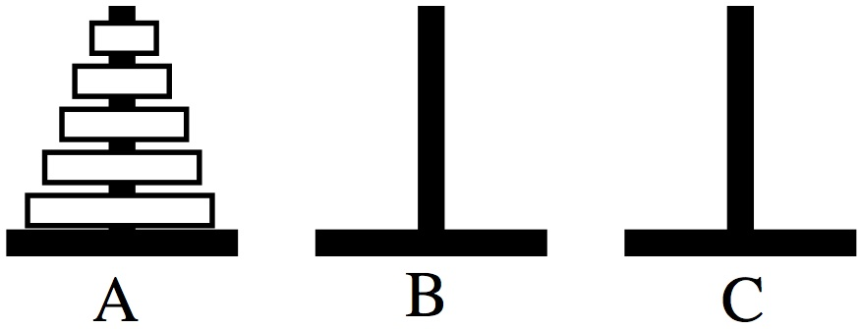
Tower of Hanoi
Only one disk may be moved at a time.
Each move consists of taking the upper disk from one of the rods and sliding it onto another rod, on top of the other disks that may already be present on that rod.
No disk may be placed on top of a smaller disk.

Slide 4
Tower of Hanoi
STACK: Last In First Out
Stack 1
Stack 2
Stack 3
http://en.wikipedia.org/wiki/File:Tower_of_Hanoi_4.gif

Slide 5
Cortex-M Stack
Descending stack
Grows from top to bottom
Stack Pointer (SP) (R13) contains memory address of top element of the stack
decremented on PUSH
incremented on POP
The assembly file startup.s defines stack space and initializes SP.
Notes:
A stack is a “Last-In, First-Out” (LIFO) data structure in which data is retrieved in the
opposite order from which it was written. Processors implement stacks by allocating a
region of memory for the stack and maintaining a “stack pointer” (SP) register that
holds the address of the next stack location to be accessed, called the top of the stack.
Stack grows down (towards lower memory addresses). A “push” operation writes data to the
top of the stack and a “pop” operation reads data from the top of the stack. Push and pop
operations adjust the SP so that the location designated as the top of the stack automatically
moves up and down in memory as push and pop instructions are executed

Slide 6
Stack
PUSH {Rd}
SP = SP-4 ⟶ Stack grows downward
(*SP) = Rd ⟶ Rd is pushed and assigned to top element of stack (C Syntax)
POP {Rd}
Rd = (*SP) ⟶ Top element of stack is popped and assigned to Rd (C Syntax)
SP = SP + 4 ⟶ Stack shrinks upward
Notes:
The order in which registers listed in the register list does not matter.
When popping multiple registers, these registers are automatically sorted by name and the lowest-numbered register is loaded from the lowest memory address, i.e. is loaded first.

Slide 7
Example: Swap R1 & R2
Before execution
R1==0x11111111
R2==0x22222222
R1
0x11111111
R2
0x22222222
PUSH {R1}
PUSH {R2}
POP {R1}
POP {R2}
Address
R13 (SP)
0x20000200
xxxxxxxx
0x20000200
xxxxxxxx
0x200001FC
xxxxxxxx
0x200001F8
memory

Slide 8
Example: Swap R1 & R2
R1
0x11111111
R2
0x22222222
PUSH {R1}
PUSH {R2}
POP {R1}
POP {R2}
Address
PC
R13 (SP)
0x200001FC
xxxxxxxx
0x20000200
0x11111111
0x200001FC
xxxxxxxx
0x200001F8
memory

Slide 9
Example: Swap R1 & R2
R1
0x11111111
R2
0x22222222
PUSH {R1}
PUSH {R2}
POP {R1}
POP {R2}
Address
R13 (SP)
0x200001F8
PC
xxxxxxxx
0x20000200
0x11111111
0x200001FC
0x22222222
0x200001F8
memory

Slide 10
Example: Swap R1 & R2
R1
0x22222222
R2
0x22222222
PUSH {R1}
PUSH {R2}
POP {R1}
POP {R2}
Address
R13 (SP)
0x200001FC
xxxxxxxx
0x20000200
PC
0x11111111
0x200001FC
0x22222222
0x200001F8
memory

Slide 11
Example: Swap R1 & R2
Before execution
R1==0x11111111
R2==0x22222222
R1
0x22222222
R2
0x11111111
PUSH {R1}
PUSH {R2}
POP {R1}
POP {R2}
Address
R13 (SP)
0x20000200
xxxxxxxx
0x20000200
0x11111111
0x200001FC
PC
0x22222222
0x200001F8
After execution
R1==0x22222222
R2==0x11111111
memory
Not an efficient approach for swapping numbers! Incurs 4 memory
accesses. Much more efficient to use another register to do swap.

Slide 12
PUSH/POP Multiple Registers
They are equivalent.
PUSH {r8}
PUSH {r7}
PUSH {r6}
PUSH {r6, r7, r8}
PUSH {r8, r7, r6}
They are equivalent.
POP {r6}
POP {r7}
POP {r8}
POP {r6, r7, r8}
POP {r8, r7, r6}
PUSH/POP multiple registers in a single statement: the order in which registers listed in the {register list} does not matter
When pushing multiple registers, these registers are automatically sorted by name and the lowest-numbered register is stored to the lowest memory address, i.e. is stored last.
When popping multiple registers, these registers are automatically sorted by name and the lowest-numbered register is loaded from the lowest memory address, i.e. is loaded first.
PUSH {register list} followed by POP{register list} leaves the values in register list unchanged. Useful for saving and restoring register values in functions.

Slide 13
Quiz
Are the values of R1 and R2 swapped?
PUSH {R1, R2}
POP {R1, R2}
Answer: No. This code is equivalent to:
PUSH {R2}
PUSH {R1}
POP {R1}
POP {R2}
This leaves R1 and R2 unchanged
The following programs perform swap:
PUSH {R1, R2}
POP {R2}
POP {R1}
or
PUSH {R1}
PUSH {R2}
POP {R1, R2}

Slide 14
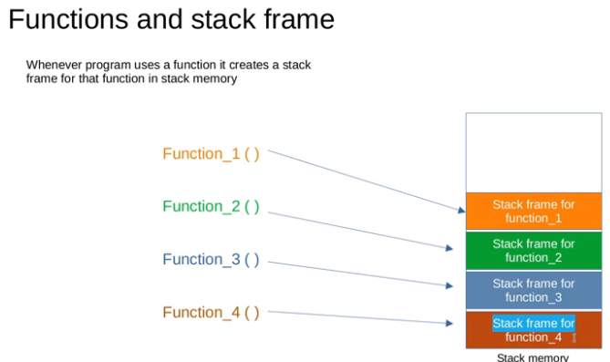
Function
A function, also called a subroutine or a procedure
Single-entry, single-exit
Returns to caller after it exits
When a function is called, the Link Register (LR) holds the memory address of the next instruction to be executed after the function exits.
PC + 4

Slide 15
Link Register
Link Register (LR) holds the return address of the current function call.
MSP: Main Stack Pointer
PSP: Process Stack Pointer

Slide 16
Calling a function: Two Ways
BL label
Equiv. operation:
LR = PC + 4
PC = label
BX LR
Equiv. operation:
PC = LR
BL label
Equiv. operation:
LR = PC + 4
PC = label
PUSH{LR}
...
POP{PC}
Equiv. operation:
PC = LR
Caller Program
... BL foo ...
Caller Program
... BL foo ...
function/Callee
foo PROC ... ... BX LR ENDP
function/Callee
foo PROC PUSH {LR} ... POP {PC} ENDP
Notes:
After call, LR holds return address (the instruction following the call)
Notes:
label is name of function
The PROC/ENDP directives mark the start/end of a function
For programmer’s convenience only, they are not present in the final machine code

Slide 17
Notes on Previous Slide
foo is name of function
The PROC/ENDP directives mark the start/end of a function
For programmer’s convenience only, they are not present in the final machine code
Equivalently: FUNC/ENDFUNC
The two approaches (BX or PUSH{LR}+POP{PC} in callee) are functionally equivalent
BX approach is more efficient since it does not access memory

Slide 18
Calling a function: BX LR
C Code:
void foo(void);
Main() {
● ● ●
foo();
● ● ●}
Compiler
Assembler Code:
● ● ●
BL foo
● ● ●
export foo
foo PROC
● ● ●
BX LR
ENDP

Slide 19
Calling a function: PUSH(LR)+POP(PC)
C Code:
void foo(void);
Main() {
● ● ●
foo();
● ● ●}
Compiler
Assembler Code:
● ● ●
BL foo
● ● ●
export foo
foo PROC
PUSH {LR}
● ● ●
POP {PC}
ENDP

Slide 20
Calling a function w/ Saving/Restoring R4-R11
Option 1 with BX LR
Option 2 with PUSH{LR}+POP{PC}
export foo
foo PROC
PUSH {R4,R5}
● ● ●
POP {R4,R5}
BX LR
ENDP
export foo
foo PROC
PUSH {R4,R5, LR}
● ● ●
POP {R4,R5, PC}
ENDP
Since LR is R14, the above is equivalent to:
export foo
foo PROC
PUSH {LR}
PUSH {R4,R5}
● ● ●
POP {R4,R5}
POP {PC}
ENDP

Slide 21
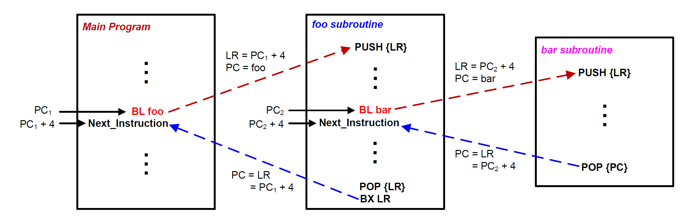
Nested Function Call w/ BX in Callee
● ● ●
BX LR
Using the BL+BX approach: since register LR can hold only a single return address, a function that calls other functions must preserve LR at its entry point and restore its original content before returning, by using PUSH(LR) and POP(LR) instructions to store and load the first caller’s return address LR in memory.

Slide 22
Nested Function Call w/ PUSH(LR)+POP(PC) in Callee
POP{PC}
Using the PUSH{LR}+POP{PC} approach, every function has the same form, so you don’t have to modify the code if you add one more level of nested function call

Slide 23
Nested Function Call: R0 = R0⁴
MAIN PROC
MOV R0,#2
BL QUAD
ENDL ...
ENDP
QUAD PROC
PUSH {LR}
BL SQ
BL SQ
POP {LR}
BX LR
ENDP
SQ PROC
MUL R0,R0,R0
BX LR
ENDP
function MAIN
function SQ
function QUAD
MAIN calls QUAD, QUAD calls SQ
Register R0 is used to pass both the argument and the return result (R0 = R0⁴)
Assume 32-bit memory address. Every item (register, instruction, data on stack) is 32 bits = 4 Bytes.

Slide 24
Example: R0 = R0⁴
Stack in Data Memory
MOV R0,#2
BL QUAD
B ENDL
SQ MUL R0…
BX LR
QUAD PUSH {LR}
BL SQ
BL SQ
POP {LR}
BX LR
ENDL ...
xxxxxxxx
0x20000200
0x200001FC
0x200001F8
R0
MOV R0,#2
0x08000138
BL QUAD
0x0800013C
B ENDL
0x08000140
SP
0x20000200
SQ
MUL R0…
0x08000144
LR
BX LR
0x08000148
PC
0x08000138
QUAD
PUSH {LR}
0x0800014C
CPU Registers
BL SQ
0x08000150
BL SQ
0x08000154
POP {LR}
0x08000158
BX LR
0x0800015C
Program in Instruction memory

Slide 25
Example: R0 = R0⁴
Stack in Data Memory
MOV R0,#2
BL QUAD
B ENDL
SQ MUL R0…
BX LR
QUAD PUSH {LR}
BL SQ
BL SQ
POP {LR}
BX LR
ENDL ...
xxxxxxxx
0x20000200
0x200001FC
0x200001F8
R0
0x02
MOV R0,#2
0x08000138
BL QUAD
0x0800013C
B ENDL
0x08000140
SP
0x20000200
SQ
MUL R0…
0x08000144
LR
BX LR
0x08000148
PC
0x0800013C
QUAD
PUSH {LR}
0x0800014C
CPU Registers
BL SQ
0x08000150
BL SQ
0x08000154
POP {LR}
0x08000158
BX LR
0x0800015C
Program in Instruction memory

Slide 26
Example: R0 = R0⁴
Stack in Data Memory
MOV R0,#2
BL QUAD
B ENDL
SQ MUL R0…
BX LR
QUAD PUSH {LR}
BL SQ
BL SQ
POP {LR}
BX LR
ENDL ...
xxxxxxxx
0x20000200
0x200001FC
0x200001F8
R0
0x02
MOV R0,#2
0x08000138
BL QUAD
0x0800013C
B ENDL
0x08000140
SP
0x20000200
SQ
MUL R0…
0x08000144
LR
0x08000140
BX LR
0x08000148
PC
0x0800014C
QUAD
PUSH {LR}
0x0800014C
CPU Registers
BL SQ
0x08000150
BL SQ
0x08000154
Preserve
Link Register (LR)
POP {LR}
0x08000158
BX LR
0x0800015C
Program in Instruction memory

Slide 27
Example: R0 = R0⁴
Stack in Data Memory
MOV R0,#2
BL QUAD
B ENDL
SQ MUL R0…
BX LR
QUAD PUSH {LR}
BL SQ
BL SQ
POP {LR}
BX LR
ENDL ...
xxxxxxxx
0x20000200
0x08000140
0x200001FC
0x200001F8
R0
0x02
MOV R0,#2
0x08000138
BL QUAD
0x0800013C
B ENDL
0x08000140
SP
0x200001FC
SQ
MUL R0…
0x08000144
LR
0x08000140
BX LR
0x08000148
PC
0x08000150
QUAD
PUSH {LR}
0x0800014C
CPU Registers
BL SQ
0x08000150
BL SQ
0x08000154
POP {LR}
0x08000158
BX LR
0x0800015C
Program in Instruction memory

Slide 28
Example: R0 = R0⁴
Stack in Data Memory
MOV R0,#2
BL QUAD
B ENDL
SQ MUL R0…
BX LR
QUAD PUSH {LR}
BL SQ
BL SQ
POP {LR}
BX LR
ENDL ...
xxxxxxxx
0x20000200
0x08000140
0x200001FC
0x200001F8
R0
0x02
MOV R0,#2
0x08000138
BL QUAD
0x0800013C
B ENDL
0x08000140
SP
0x200001FC
SQ
MUL R0…
0x08000144
LR
0x08000154
BX LR
0x08000148
PC
0x08000144
QUAD
PUSH {LR}
0x0800014C
CPU Registers
BL SQ
0x08000150
BL SQ
0x08000154
POP {LR}
0x08000158
BX LR
0x0800015C
Program in Instruction memory

Slide 29
Example: R0 = R0⁴
Stack in Data Memory
MOV R0,#2
BL QUAD
B ENDL
SQ MUL R0…
BX LR
QUAD PUSH {LR}
BL SQ
BL SQ
POP {LR}
BX LR
ENDL ...
xxxxxxxx
0x20000200
0x08000140
0x200001FC
0x200001F8
R0
0x04
MOV R0,#2
0x08000138
BL QUAD
0x0800013C
B ENDL
0x08000140
SP
0x200001FC
SQ
MUL R0…
0x08000144
LR
0x08000154
BX LR
0x08000148
PC
0x08000148
QUAD
PUSH {LR}
0x0800014C
CPU Registers
BL SQ
0x08000150
BL SQ
0x08000154
POP {LR}
0x08000158
BX LR
0x0800015C
Program in Instruction memory

Slide 30
Example: R0 = R0⁴
Stack in Data Memory
MOV R0,#2
BL QUAD
B ENDL
SQ MUL R0…
BX LR
QUAD PUSH {LR}
BL SQ
BL SQ
POP {LR}
BX LR
ENDL ...
xxxxxxxx
0x20000200
0x08000140
0x200001FC
0x200001F8
R0
0x04
MOV R0,#2
0x08000138
BL QUAD
0x0800013C
B ENDL
0x08000140
SP
0x200001FC
SQ
MUL R0…
0x08000144
LR
0x08000154
BX LR
0x08000148
PC
0x08000154
QUAD
PUSH {LR}
0x0800014C
CPU Registers
BL SQ
0x08000150
BL SQ
0x08000154
POP {LR}
0x08000158
BX LR
0x0800015C
Program in Instruction memory

Slide 31
Example: R0 = R0⁴
Stack in Data Memory
MOV R0,#2
BL QUAD
B ENDL
SQ MUL R0…
BX LR
QUAD PUSH {LR}
BL SQ
BL SQ
POP {LR}
BX LR
ENDL ...
xxxxxxxx
0x20000200
0x08000140
0x200001FC
0x200001F8
R0
0x04
MOV R0,#2
0x08000138
BL QUAD
0x0800013C
B ENDL
0x08000140
SP
0x200001FC
SQ
MUL R0…
0x08000144
LR
0x08000158
BX LR
0x08000148
PC
0x08000144
QUAD
PUSH {LR}
0x0800014C
CPU Registers
BL SQ
0x08000150
BL SQ
0x08000154
POP {LR}
0x08000158
BX LR
0x0800015C
Program in Instruction memory

Slide 32
Example: R0 = R0⁴
Stack in Data Memory
MOV R0,#2
BL QUAD
B ENDL
SQ MUL R0…
BX LR
QUAD PUSH {LR}
BL SQ
BL SQ
POP {LR}
BX LR
ENDL ...
xxxxxxxx
0x20000200
0x08000140
0x200001FC
0x200001F8
R0
0x10
MOV R0,#2
0x08000138
BL QUAD
0x0800013C
B ENDL
0x08000140
SP
0x200001FC
SQ
MUL R0…
0x08000144
LR
0x08000158
BX LR
0x08000148
PC
0x08000148
QUAD
PUSH {LR}
0x0800014C
CPU Registers
BL SQ
0x08000150
BL SQ
0x08000154
POP {LR}
0x08000158
BX LR
0x0800015C
Program in Instruction memory

Slide 33
Example: R0 = R0⁴
Stack in Data Memory
MOV R0,#2
BL QUAD
B ENDL
SQ MUL R0…
BX LR
QUAD PUSH {LR}
BL SQ
BL SQ
POP {LR}
BX LR
ENDL ...
xxxxxxxx
0x20000200
0x08000140
0x200001FC
0x200001F8
R0
0x10
MOV R0,#2
0x08000138
BL QUAD
0x0800013C
B ENDL
0x08000140
SP
0x200001FC
SQ
MUL R0…
0x08000144
LR
0x08000158
BX LR
0x08000148
PC
0x08000158
QUAD
PUSH {LR}
0x0800014C
CPU Registers
BL SQ
0x08000150
BL SQ
0x08000154
POP {LR}
0x08000158
BX LR
0x0800015C
Program in Instruction memory

Slide 34
Example: R0 = R0⁴
Stack in Data Memory
MOV R0,#2
BL QUAD
B ENDL
SQ MUL R0…
BX LR
QUAD PUSH {LR}
BL SQ
BL SQ
POP {LR}
BX LR
ENDL ...
xxxxxxxx
0x20000200
0x08000140
0x200001FC
0x200001F8
R0
0x10
MOV R0,#2
0x08000138
BL QUAD
0x0800013C
B ENDL
0x08000140
SP
0x20000200
SQ
MUL R0…
0x08000144
LR
0x08000140
BX LR
0x08000148
PC
0x0800015C
QUAD
PUSH {LR}
0x0800014C
CPU Registers
BL SQ
0x08000150
BL SQ
0x08000154
Recover
Link Register (LR)
POP {LR}
0x08000158
BX LR
0x0800015C
Program in Instruction memory

Slide 35
Example: R0 = R0⁴
Stack in Data Memory
MOV R0,#2
BL QUAD
B ENDL
SQ MUL R0…
BX LR
QUAD PUSH {LR}
BL SQ
BL SQ
POP {LR}
BX LR
ENDL ...
xxxxxxxx
0x20000200
0x08000140
0x200001FC
0x200001F8
R0
0x10
MOV R0,#2
0x08000138
BL QUAD
0x0800013C
B ENDL
0x08000140
SP
0x20000200
SQ
MUL R0…
0x08000144
LR
0x08000140
BX LR
0x08000148
PC
0x08000140
QUAD
PUSH {LR}
0x0800014C
CPU Registers
BL SQ
0x08000150
BL SQ
0x08000154
POP {LR}
0x08000158
BX LR
0x0800015C
Program in Instruction memory

Slide 36
Arguments and Return Values
Hold arguments, results, or temporary values. Caller doesn’t expect them to be preserved. Also called “scratch registers”.
Caller expects these values to be preserved.
Callee either does not use them, or must preserve their original value if it uses them.
Link Register
Notes:
R0-R3: scratch registers that can be changed by callee
R4-R11: caller expects their value to stay unchanged before and after a function call

Slide 37
On Conventions
“Callee must preserve values of R4-R11, but not R0-R3”
This is a programming convention adopted by ARM compilers and assemblers that helps with interoperability among software written by different people (the processor hardware doesn’t care how you use the registers)
Like driving on the right side of the road in North America (the road doesn’t care how cars are driven on it)
What if you don’t respect this convention?
If you write everything (assembler code, compiler toolchain…) by yourself, free to adopt your own convention, but your code or tool will not interoperate with the rest of the world

Slide 38
Calling a Function without Preserving R4-R11
Caller Program | function/Callee
MOV R4, #100 ... BL foo % R4 has the incorrect value of 10 ... ADD R4, R4, #1 | foo PROC ... MOV R4, #10 ; foo changes R4 ... BX LR ENDP
Callee must preserve values of R4-R11

Slide 39
Calling a Function, Preserving r4-r11
Caller Program | function/Callee
MOV R4, #100 ... BL foo % R4 has the correct value of 100 ... ADD R4, R4, #1 | foo PROC PUSH {R4} ; preserve R4 ... MOV R4, #10 ; foo changes R4 ... POP {R4} ; Recover R4 BX LR ENDP
Callee must preserve values of R4-R11

Slide 40
Passing Arguments via Registers R0-R3

Slide 41
Additional Arguments Passed on Stack
Registers
Stack in Memory
R0 | R1 | R2 | R3
foo (int i0, int i1, int i2, int i3)
Registers
Stack in Memory
i0 | i1 | i2 | i3
Each argument of 8-bit char, or 16-bit short, is passed in a 32-bit register
foo (int i0, char a1, double D)
Registers
Stack in Memory
i0 | a1 | D
foo (int i0, int i1, double D, int i2, int i3)
Registers
Stack in Memory
i0 | i1 | D
i2 | i3
Caller passes arguments i0, i1, D in registers R0-R3 directly; pushes additional arguments i2 and i3 onto the stack before function call (details not covered in this lecture)

Slide 42
Example: R2 = R0*R0+R1*R1
MOV R0,#3
MOV R1,#4
BL SSQ
MOV R2,R0
B ENDL
...
SSQ MUL R2,R0,R0
MUL R3,R1,R1
ADD R2,R2,R3
MOV R0,R2
BX LR
...
R1: second argument
R0: first argument
int SSQ(int x, int y){
int z;
z = x * x + y * y;
return z;
}
R0: Return Value

Slide 43
Redundancy?
This program does not use the stack
No nested function calls
All arguments fit in R0-R3
Why do you have “MOV R0, R2” in the callee, and “MOV R2,R0” in the caller? Aren’t they redundant?
Return value must be in R0, hence must have “MOV R0, R2” in the callee before return
The specification says “R2=R0*R0+R1*R1”, hence “MOV R2, R0” in the caller after function return
Actually the program can be rewritten to improve efficiency. See next slide.

Slide 44
Example simplified: R0 = R0*R0+R1*R1
MOV R0,#3
MOV R1,#4
BL SSQ
B ENDL
...
SSQ MUL R0,R0,R0
MUL R1,R1,R1
ADD R0,R0,R1
BX LR
...
This version uses fewer registers and is more efficient.
But we use the previous version for illustration purpose
R1: second argument
R0: first argument
int SSQ(int x, int y){
int z;
z = x * x + y * y;
return z;
}
R0: Return Value

Slide 45
Example: R2 = R0*R0+R1*R1
R0
MOV R0,#3
MOV R1,#4
BL SSQ
MOV R2,R0
B ENDL
SSQ MUL R2,R0,R0
MUL R3,R1,R1
ADD R2,R2,R3
MOV R0,R2
BX LR
ENDL ...
R1
Memory Address
R2
R3
MOV R0,#3
0x08000128
MOV R1,#4
0x0800012C
LR
BL SSQ
0x0800012F
PC
0x08000128
MOV R2,R0
0x08000134
B ENDL
0x08000138
CPU Registers
SSQ
MUL R2,...
0x0800013B
MUL R3,...
0x0800013F
ADD R2,R3
0x08000144
MOV R0,R2
0x08000146
BX LR
0x0800014A
Program in Instruction memory

Slide 46
Example: R2 = R0*R0+R1*R1
R0
3
MOV R0,#3
MOV R1,#4
BL SSQ
MOV R2,R0
B ENDL
SSQ MUL R2,R0,R0
MUL R3,R1,R1
ADD R2,R2,R3
MOV R0,R2
BX LR
ENDL ...
R1
Memory Address
R2
R3
MOV R0,#3
0x08000128
MOV R1,#4
0x0800012C
LR
BL SSQ
0x0800012F
PC
0x08000128
MOV R2,R0
0x08000134
B ENDL
0x08000138
CPU Registers
SSQ
MUL R2,...
0x0800013B
MUL R3,...
0x0800013F
ADD R2,R3
0x08000144
MOV R0,R2
0x08000146
BX LR
0x0800014A
Program in Instruction memory

Slide 47
Example: R2 = R0*R0+R1*R1
R0
3
MOV R0,#3
MOV R1,#4
BL SSQ
MOV R2,R0
B ENDL
SSQ MUL R2,R0,R0
MUL R3,R1,R1
ADD R2,R2,R3
MOV R0,R2
BX LR
ENDL ...
R1
4
Memory Address
R2
R3
MOV R0,#3
0x08000128
MOV R1,#4
0x0800012C
LR
BL SSQ
0x0800012F
PC
0x0800012B
MOV R2,R0
0x08000134
B ENDL
0x08000138
CPU Registers
SSQ
MUL R2,...
0x0800013B
MUL R3,...
0x0800013F
ADD R2,R3
0x08000144
MOV R0,R2
0x08000146
BX LR
0x0800014A
Program in Instruction memory

Slide 48
Example: R2 = R0*R0+R1*R1
R0
3
MOV R0,#3
MOV R1,#4
BL SSQ
MOV R2,R0
B ENDL
SSQ MUL R2,R0,R0
MUL R3,R1,R1
ADD R2,R2,R3
MOV R0,R2
BX LR
ENDL ...
R1
4
Memory Address
R2
R3
MOV R0,#3
0x08000128
MOV R1,#4
0x0800012C
LR
BL SSQ
0x0800012F
PC
0x0800012F
MOV R2,R0
0x08000134
B ENDL
0x08000138
SSQ
MUL R2,...
0x0800013B
MUL R3,...
0x0800013F
ADD R2,R3
0x08000144
MOV R0,R2
0x08000146
BX LR
0x0800014A

Slide 49
Example: R2 = R0*R0+R1*R1
R0
3
MOV R0,#3
MOV R1,#4
BL SSQ
MOV R2,R0
B ENDL
SSQ MUL R2,R0,R0
MUL R3,R1,R1
ADD R2,R2,R3
MOV R0,R2
BX LR
ENDL ...
R1
4
Memory Address
R2
R3
MOV R0,#3
0x08000128
MOV R1,#4
0x0800012C
LR
0x08000134
BL SSQ
0x0800012F
PC
0x0800013B
MOV R2,R0
0x08000134
B ENDL
0x08000138
CPU Registers
SSQ
MUL R2,...
0x0800013B
MUL R3,...
0x0800013F
ADD R2,R3
0x08000144
MOV R0,R2
0x08000146
Address of the next instruction after the branch is saved into LR.
BX LR
0x0800014A
Program in Instruction memory

Slide 50
Example: R2 = R0*R0+R1*R1
R0
3
MOV R0,#3
MOV R1,#4
BL SSQ
MOV R2,R0
B ENDL
SSQ MUL R2,R0,R0
MUL R3,R1,R1
ADD R2,R2,R3
MOV R0,R2
BX LR
ENDL ...
R1
4
Memory Address
R2
9
R3
MOV R0,#3
0x08000128
MOV R1,#4
0x0800012C
LR
0x08000134
BL SSQ
0x0800012F
PC
0x0800013B
MOV R2,R0
0x08000134
B ENDL
0x08000138
CPU Registers
SSQ
MUL R2,...
0x0800013B
MUL R3,...
0x0800013F
ADD R2,R3
0x08000144
MOV R0,R2
0x08000146
BX LR
0x0800014A
Program in Instruction memory

Slide 51
Example: R2 = R0*R0+R1*R1
R0
3
MOV R0,#3
MOV R1,#4
BL SSQ
MOV R2,R0
B ENDL
SSQ MUL R2,R0,R0
MUL R3,R1,R1
ADD R2,R2,R3
MOV R0,R2
BX LR
ENDL ...
R1
4
Memory Address
R2
9
R3
16
MOV R0,#3
0x08000128
MOV R1,#4
0x0800012C
LR
0x08000134
BL SSQ
0x0800012F
PC
0x0800013F
MOV R2,R0
0x08000134
B ENDL
0x08000138
CPU Registers
SSQ
MUL R2,...
0x0800013B
MUL R3,...
0x0800013F
ADD R2,R3
0x08000144
MOV R0,R2
0x08000146
BX LR
0x0800014A
Program in Instruction memory

Slide 52
Example: R2 = R0*R0+R1*R1
R0
3
MOV R0,#3
MOV R1,#4
BL SSQ
MOV R2,R0
B ENDL
SSQ MUL R2,R0,R0
MUL R3,R1,R1
ADD R2,R2,R3
MOV R0,R2
BX LR
ENDL ...
R1
4
Memory Address
R2
25
R3
16
MOV R0,#3
0x08000128
MOV R1,#4
0x0800012C
LR
0x08000134
BL SSQ
0x0800012F
PC
0x08000144
MOV R2,R0
0x08000134
B ENDL
0x08000138
CPU Registers
SSQ
MUL R2,...
0x0800013B
MUL R3,...
0x0800013F
ADD R2,R3
0x08000144
MOV R0,R2
0x08000146
BX LR
0x0800014A
Program in Instruction memory

Slide 53
Example: R2 = R0*R0+R1*R1
R0
25
MOV R0,#3
MOV R1,#4
BL SSQ
MOV R2,R0
B ENDL
SSQ MUL R2,R0,R0
MUL R3,R1,R1
ADD R2,R2,R3
MOV R0,R2
BX LR
ENDL ...
R1
4
Memory Address
R2
25
R3
16
MOV R0,#3
0x08000128
MOV R1,#4
0x0800012C
LR
0x08000134
BL SSQ
0x0800012F
PC
0x08000146
MOV R2,R0
0x08000134
B ENDL
0x08000138
CPU Registers
SSQ
MUL R2,...
0x0800013B
MUL R3,...
0x0800013F
ADD R2,R3
0x08000144
MOV R0,R2
0x08000146
BX LR
0x0800014A
Program in Instruction memory

Slide 54
Example: R2 = R0*R0+R1*R1
R0
25
MOV R0,#3
MOV R1,#4
BL SSQ
MOV R2,R0
B ENDL
SSQ MUL R2,R0,R0
MUL R3,R1,R1
ADD R2,R2,R3
MOV R0,R2
BX LR
ENDL ...
R1
4
Memory Address
R2
25
R3
16
MOV R0,#3
0x08000128
MOV R1,#4
0x0800012C
LR
0x08000134
BL SSQ
0x0800012F
PC
0x0800014A
MOV R2,R0
0x08000134
B ENDL
0x08000138
CPU Registers
SSQ
MUL R2,...
0x0800013B
MUL R3,...
0x0800013F
ADD R2,R3
0x08000144
MOV R0,R2
0x08000146
BX LR
0x0800014A
Program in Instruction memory

Slide 55
Example: R2 = R0*R0+R1*R1
R0
25
MOV R0,#3
MOV R1,#4
BL SSQ
MOV R2,R0
B ENDL
SSQ MUL R2,R0,R0
MUL R3,R1,R1
ADD R2,R2,R3
MOV R0,R2
BX LR
ENDL ...
R1
4
Memory Address
R2
25
R3
16
MOV R0,#3
0x08000128
MOV R1,#4
0x0800012C
LR
0x08000134
BL SSQ
0x0800012F
PC
0x08000134
MOV R2,R0
0x08000134
B ENDL
0x08000138
CPU Registers
SSQ
MUL R2,...
0x0800013B
MUL R3,...
0x0800013F
ADD R2,R3
0x08000144
MOV R0,R2
0x08000146
Copy LR to PC when returning from a function!
BX LR
0x0800014A
Program in Instruction memory

Slide 56
Example: R2 = R0*R0+R1*R1
R0
25
MOV R0,#3
MOV R1,#4
BL SSQ
MOV R2,R0
B ENDL
SSQ MUL R2,R0,R0
MUL R3,R1,R1
ADD R2,R2,R3
MOV R0,R2
BX LR
ENDL ...
R1
4
Memory Address
R2
25
R3
16
MOV R0,#3
0x08000128
MOV R1,#4
0x0800012C
LR
0x08000134
BL SSQ
0x0800012F
PC
0x08000134
MOV R2,R0
0x08000134
B ENDL
0x08000138
CPU Registers
SSQ
MUL R2,...
0x0800013B
MUL R3,...
0x0800013F
ADD R2,R3
0x08000144
MOV R0,R2
0x08000146
BX LR
0x0800014A
Program in Instruction memory

Slide 57
Example: R2 = R0*R0+R1*R1
R0
25
MOV R0,#3
MOV R1,#4
BL SSQ
MOV R2,R0
B ENDL
SSQ MUL R2,R0,R0
MUL R3,R1,R1
ADD R2,R2,R3
MOV R0,R2
BX LR
ENDL ...
R1
4
Memory Address
R2
25
R3
16
MOV R0,#3
0x08000128
MOV R1,#4
0x0800012C
LR
0x08000134
BL SSQ
0x0800012F
PC
0x08000138
MOV R2,R0
0x08000134
B ENDL
0x08000138
CPU Registers
SSQ
MUL R2,...
0x0800013B
MUL R3,...
0x0800013F
ADD R2,R3
0x08000144
MOV R0,R2
0x08000146
BX LR
0x0800014A
Program in Instruction memory

Slide 58
Summary
Stack
PUSH and POP operations
Calling a function
Either BX, or PUSH(LR)+POP(PC) in callee
Calling conventions
R0-R3: scratch registers that can be changed by callee
R4-R11: caller expects their value to stay unchanged before and after a function call
Passing arguments and returning a value
Arguments passed in R0-R3, plus stack if necessary
Value returned in R0-R3, depending on its size

